Slide 1
ECE 445
Smart Shopping Cart
Spring 2013
Prof. Carney
TA: Mustafa Mukadam
Group #22
Di Fan & Ying He & Xuyang Yao

Slide 2
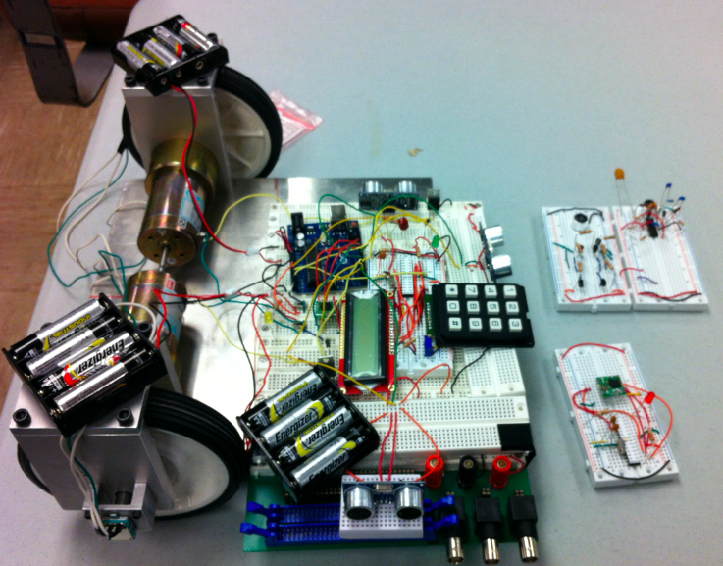
Completed project

Slide 3
Introduction
Shopping carts served only simple purposes
Cost human labor to push heavy shopping carts
Risk of collision with customers and other carts
Difficult to locate specific products in large store
Motivated to build a smart shopping cart that moves automatically and included navigation function

Slide 4
Features
Sensors with minimum detection radius of 0.2 m
High CPU calculation speed for rapid moving decision
Enclosed store map and product catalogs intended for searching function
RF transceivers update cart information

Slide 5
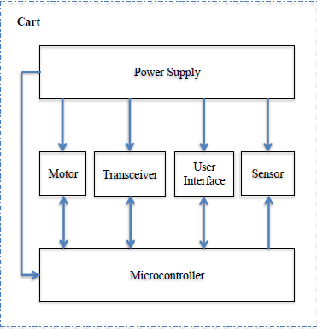
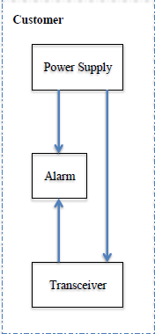
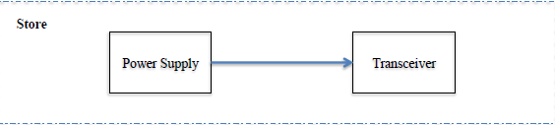
Block Diagram

Slide 6
Main Requirements and Verification
Eight AA batteries provide 11 - 13 V dc voltage
RF transceivers work at 433 MHz channel with 1 - 1.4 kbps data rate
Percentage error of cart turning angle cannot exceed 10%
Sensors precisely detect obstacles within 18 - 22 cm
LCD refreshed within 0.5 s after user input
Microcontroller determines optimal route in 5 s

Slide 7
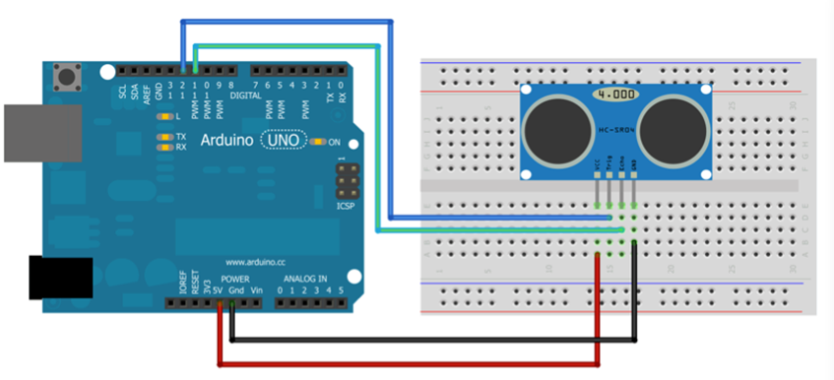
Sensor
HC-SR04 Ultrasonic Sensor
Three sensors to detect front, left and right objects

Slide 8
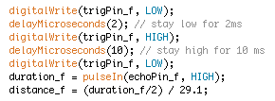
Sensor
Calculate distance between objects and sensor using echo time/2 × speed of sound in air = distance
Set 20cm as safety distance
Report to customer through RF transceivers when cart is blocked

Slide 9
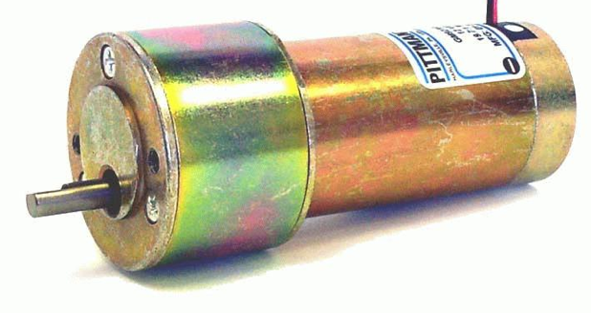
DC Motor
12V DC supply 62.5: 1 motor
Eight 1.5V batteries to power two DC motors
Lower speed but higher power - trade-off between power and speed
Rotary encoder installed to the wheels to get simple feedback

Slide 10
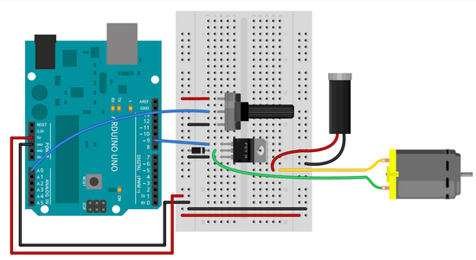
DC motor
Connection between motor and Arduino
Transistor - add a TIP120
to control high-loads
circuit
Diode - add a D1N4007 to
protect transistor from
back voltage

Slide 11
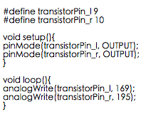
Control the speed of motor
Use Arduino PWM wave to generate voltage between 0-5V
analogWrite() on a scale of 0-255
Pin 3, 5, 6, 9, 10, 11 can output PWM wave
A piece of code that can make the cart go straight

Slide 12
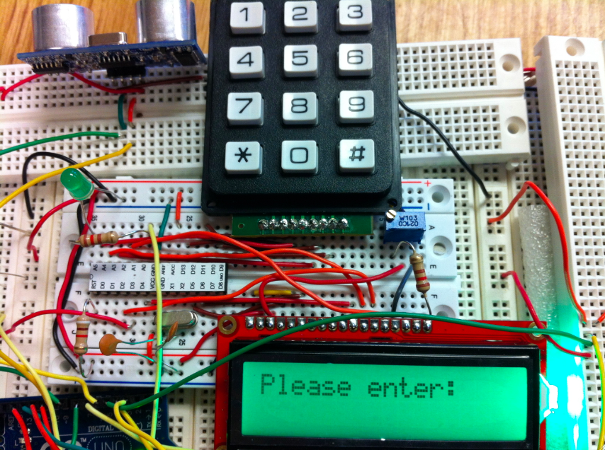
User Interface

Slide 13
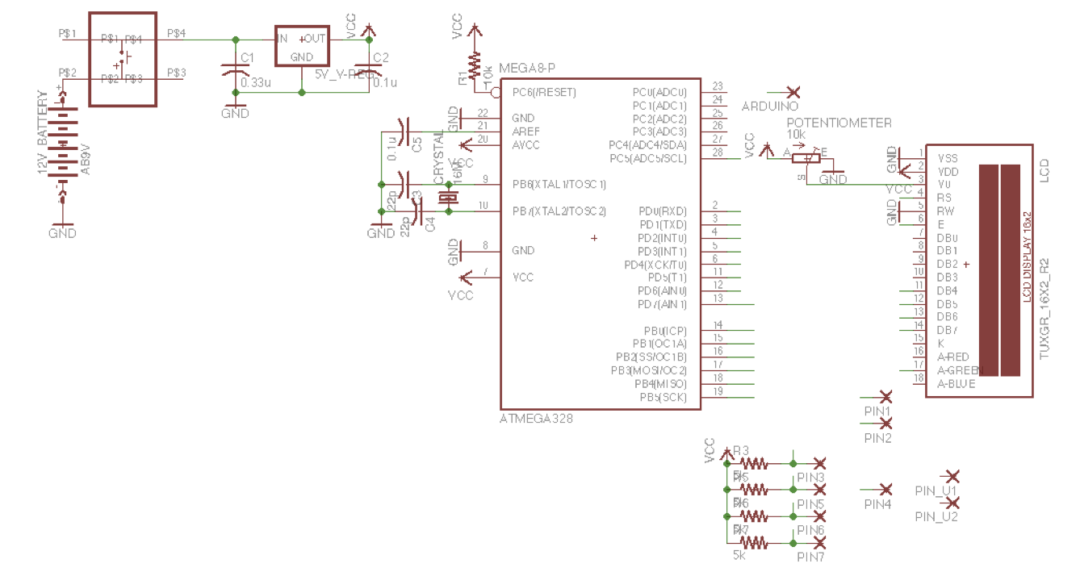
User Interface

Slide 14
User Interface
12-button keypad:
Buttons 0 – 9 represent 10 different catalogs
“#” – enter; “*” – clear all
7 pins transfer product information to microcontroller (ATmega328)
ATmega328:
Decode signals from keypad and reflect product names onto LCD
Send shopping list to Arduino for determination of optimal moving path
LCD screen:
Display the most recent item entered

Slide 15
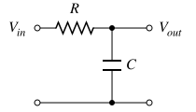
From ATmega328 to Arduino
ATmega328 sends out PWM wave from digital pin 3
AnalogWrite: 0 – 255 (0 – zero duty cycle; 255 – 100% duty cycle)
Low pass filter transfers PWM wave into analog voltage from 0 to 5 V
R = 4.8k ohms
C = 1uF
Arduino receives voltage from analog pin 3
AnalogRead: 0 - 1023

Slide 16
From ATmega328 to Arduino
Catalogs | Sent From ATmega328 (0 - 255) | Received by Arduino (0 - 1023)
Grocery (0) | 23 | 77
Kids (1) | 46 | 157
Books (2) | 69 | 237
Office (3) | 92 | 317
Health (4) | 115 | 393
Beauty (5) | 138 | 469
Sports (6) | 161 | 543
Electronics (7) | 184 | 615
Apparel (8) | 207 | 683
Home (9) | 230 | 751

Slide 17
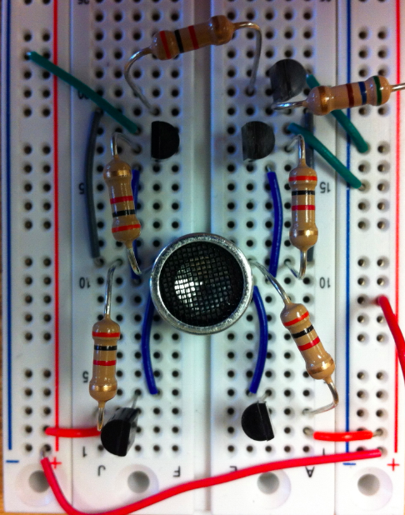
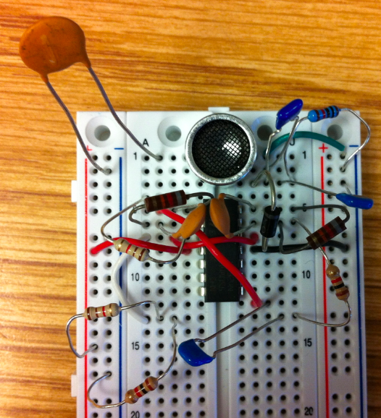
Ultrasonic Transmitter & Receiver

Slide 18
Ultrasonic Transmitter & Receiver
Self-built ultrasonic transmitter and receiver to implement the indoor positioning system
Triangulation method: three transmitters and two receivers (one for cart and one for customer)
Synchronization of transmitters: all connected to one ATmega328 microcontroller; send out sound waves at different cycles
Receivers convert wave information into voltage, which is proportional to distance travelled

Slide 19
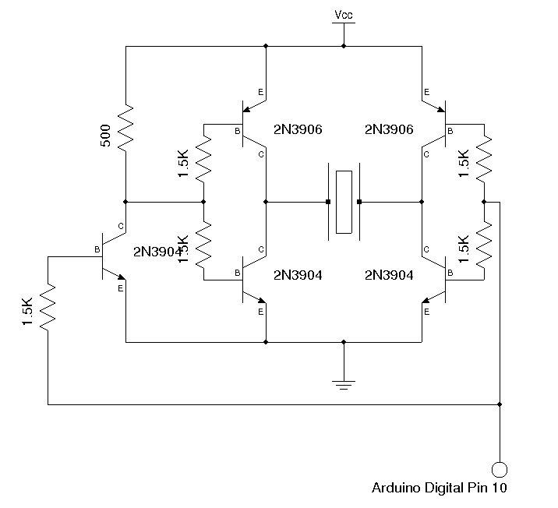
Ultrasonic Transmitter
Operation frequency:
40 kHz, generated by
timer2 of ATmega328
Transmitter driving
voltage: < 30 V
H-bridge: double
source voltage at
transmitter terminals

Slide 20
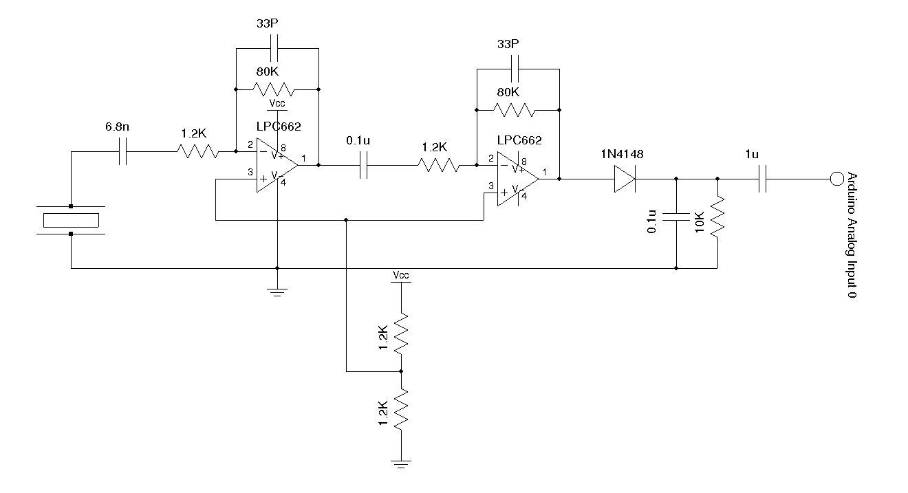
Ultrasonic Receiver
Received sound wave transfers into voltages around a few hundred millivolts
Two LM324 amplifiers in series to amplify voltage
Low pass
filter: eliminate
high frequency
noises

Slide 21
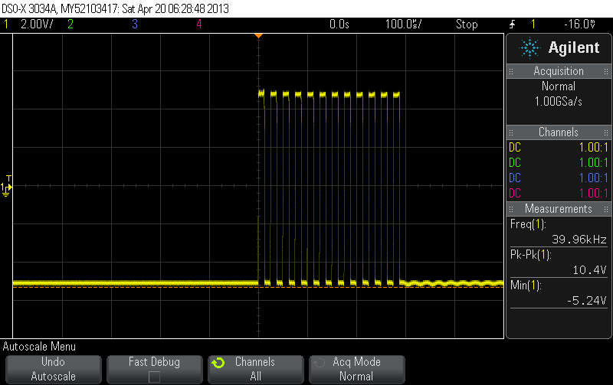
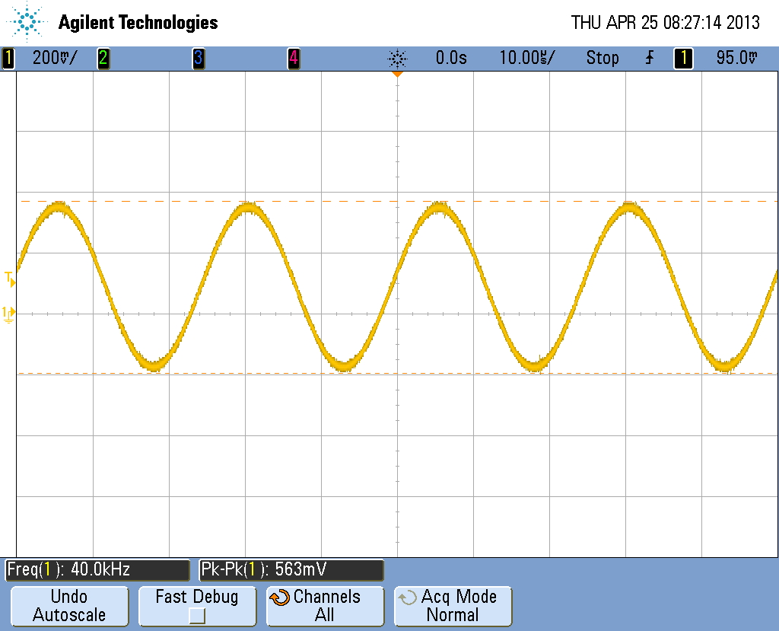
Ultrasonic Transmitter & Receiver: Experimental Results
Transmitter: Receiver:

Slide 22
Why ultrasonic fails
Receivers only receiver reliable signals when in front of transmitters: sound wave is not omni-directional
Low-frequency noises significantly interfere with desired signals for long distances due to big amplification gains
Indoor positioning system: crazy sound wave reflections

Slide 23
Navigation System
Model setup
Shelf
Cart 1 4 5 8 9
2 3 6 7 10

Slide 24
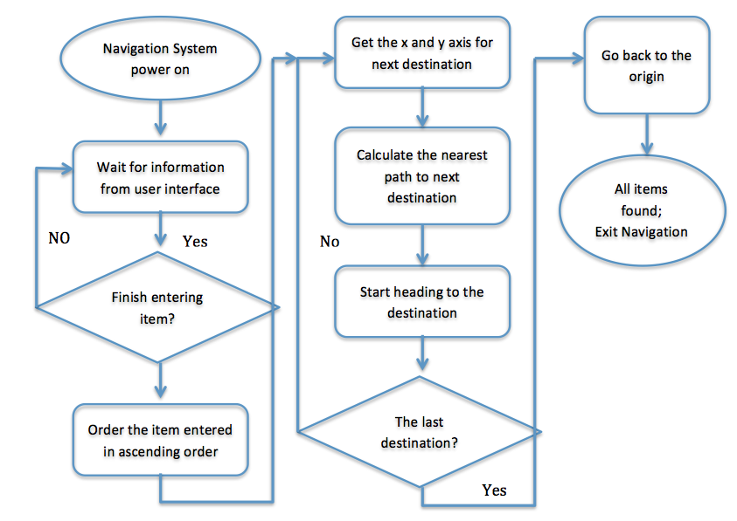
Navigation system

Slide 25
Navigation System
Advantages:
Accurately bring customer to where desired product is located
Determine the shortest path that covers all products selected
Collision avoidance - sensor detecting obstacles within 20 cm along the way. If obstacles detected, modify cart direction by 15 degrees in left or right
Alarm system - alarm sent to customer while cart is trapped

Slide 26
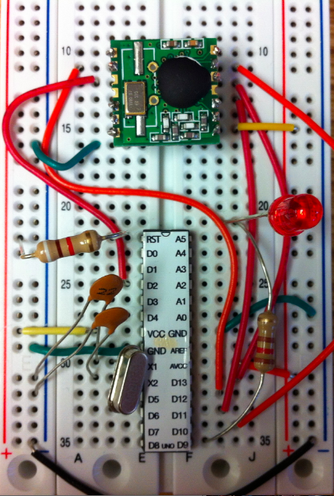
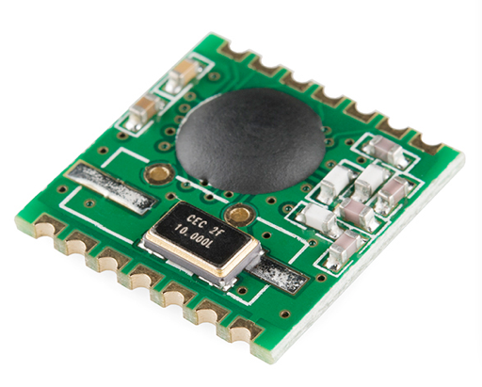
RF Transceiver
RFM12B Wireless Transceiver
Directional transmission
Three channels: 433MHz,
868MHz and 915MHz
High data rate (1.2 kbps),
stable performance

Slide 27
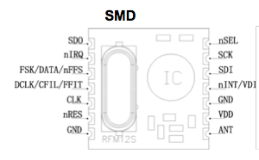
RF Transceiver
Pin assignment

Slide 28
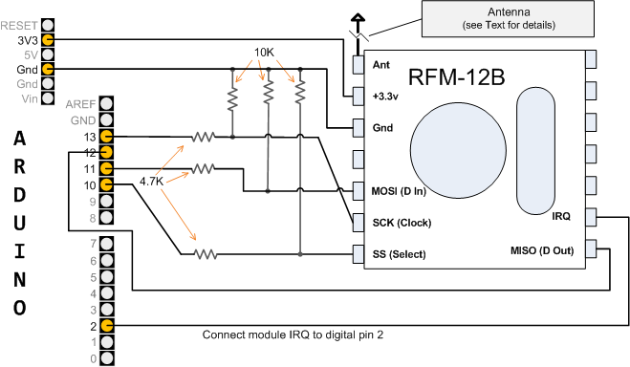
RF Transceiver
How transceiver connects to Arduino

Slide 29
RF Transceiver
Transmitter - installed on the cart
Generate and send an alarm signal when the cart is trapped
Stop sending signal when the cart is not trapped
Receiver - held by customer
The LED will blink when the alarm signal is received
Stop blinking when no signal is coming

Slide 30
References
http://playground.arduino.cc/Code/Keypad
http://www.instructables.com/id/Simple-Arduino-and-HC-SR04-Example/
http://arduino.cc/en/Tutorial/LiquidCrystal
http://www.kerrywong.com/2011/01/22/a-sensitive-diy-ultrasonic-range-sensor/
http://lowpowerlab.com/blog/tag/rfm12b/
http://luckylarry.co.uk/arduino-projects/arduino-control-a-dc-motor-with-potentiometer-and-multiple-power-supplies/

Slide 31
Special Thanks to:
Service Shop & Machine Shop!!!
Thank you for listening
Questions？

